Slide 1


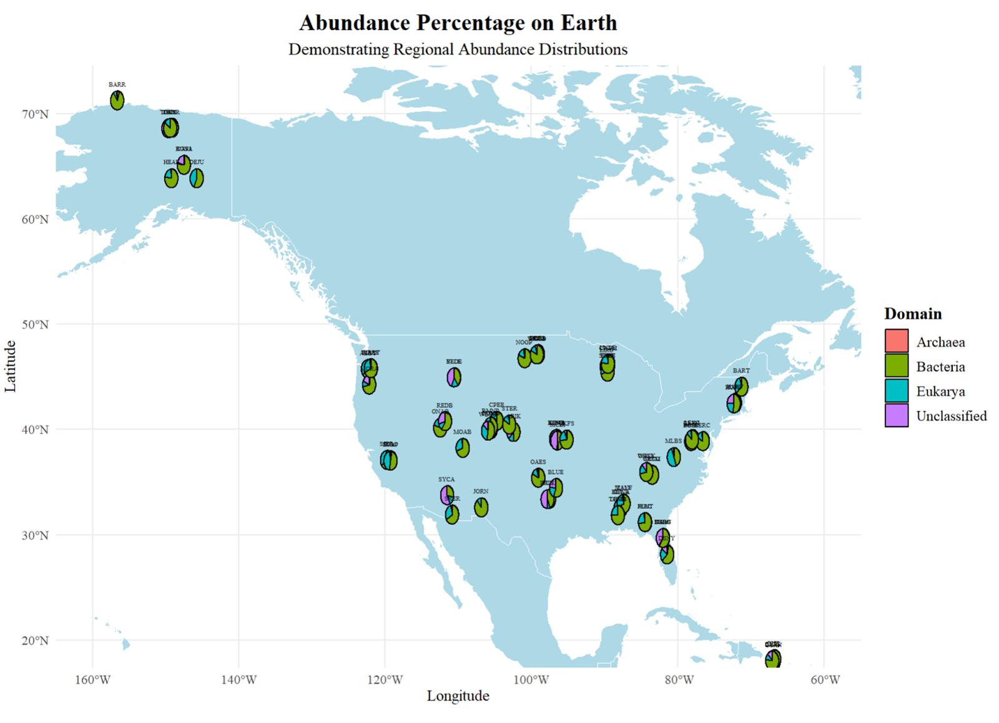
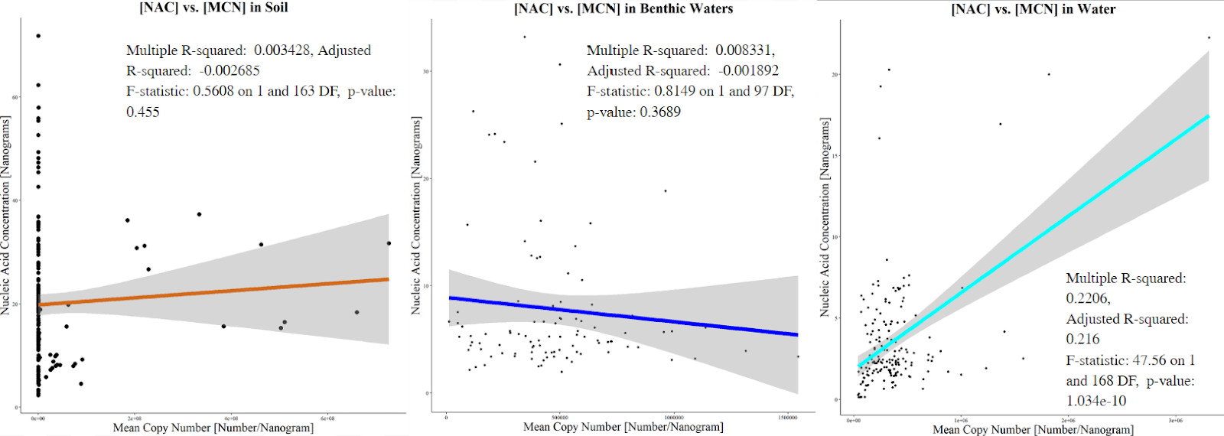
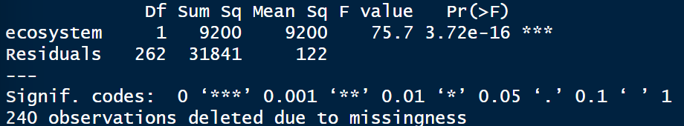
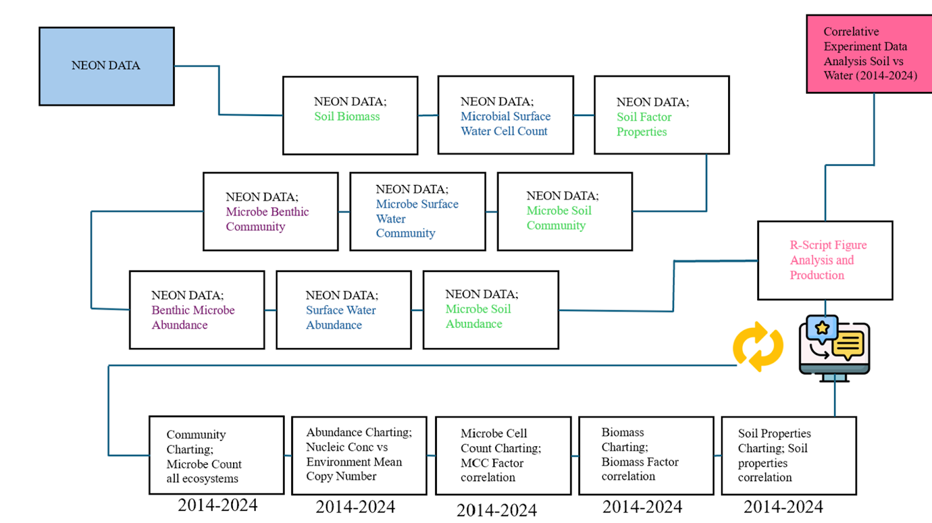
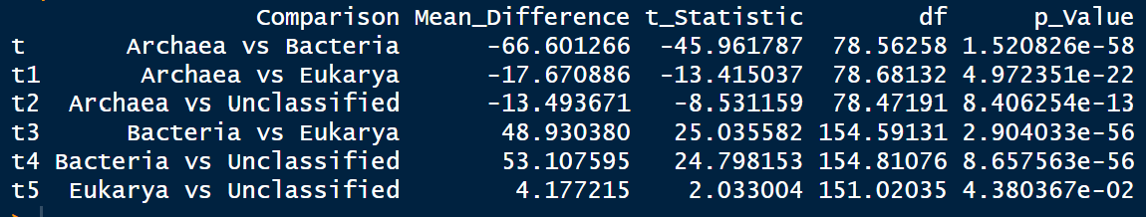
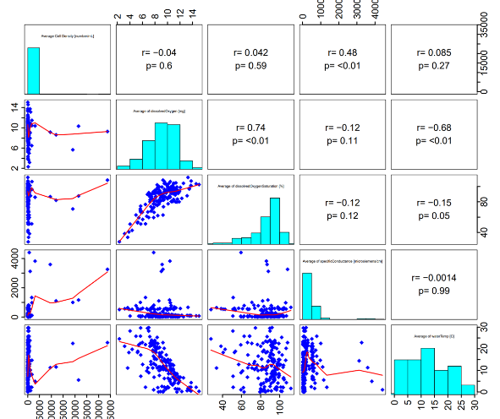
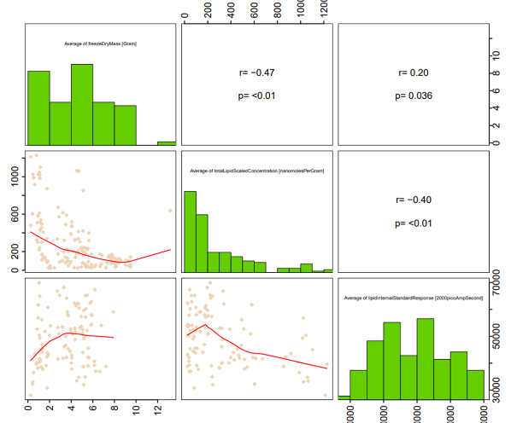
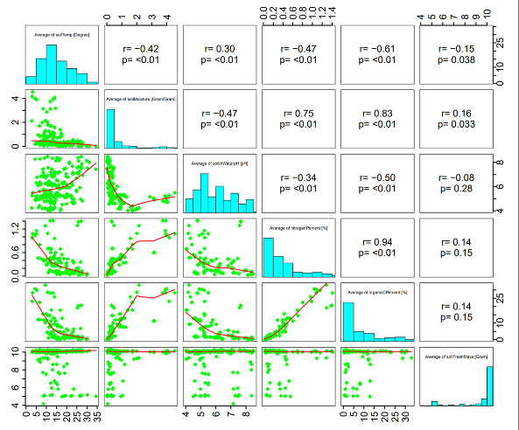
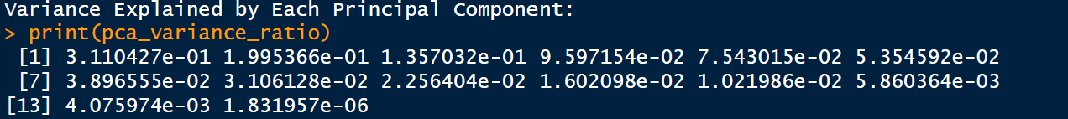
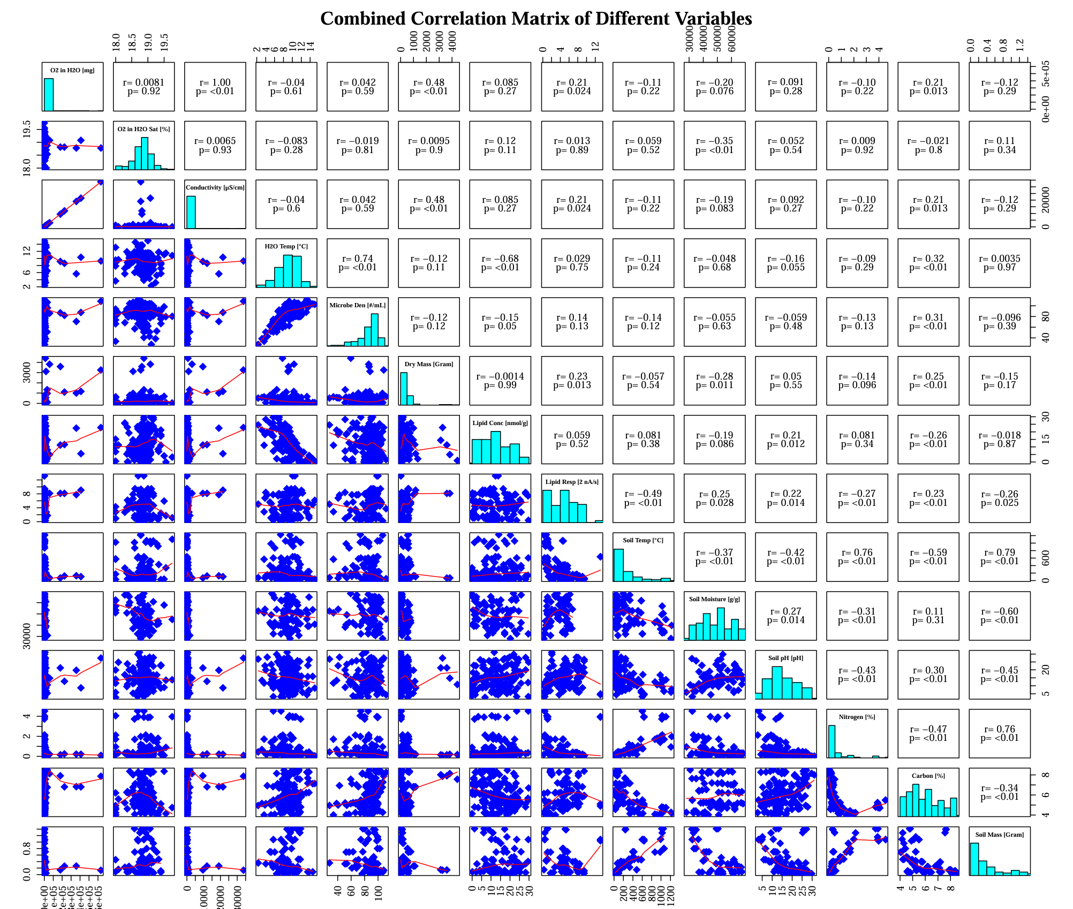
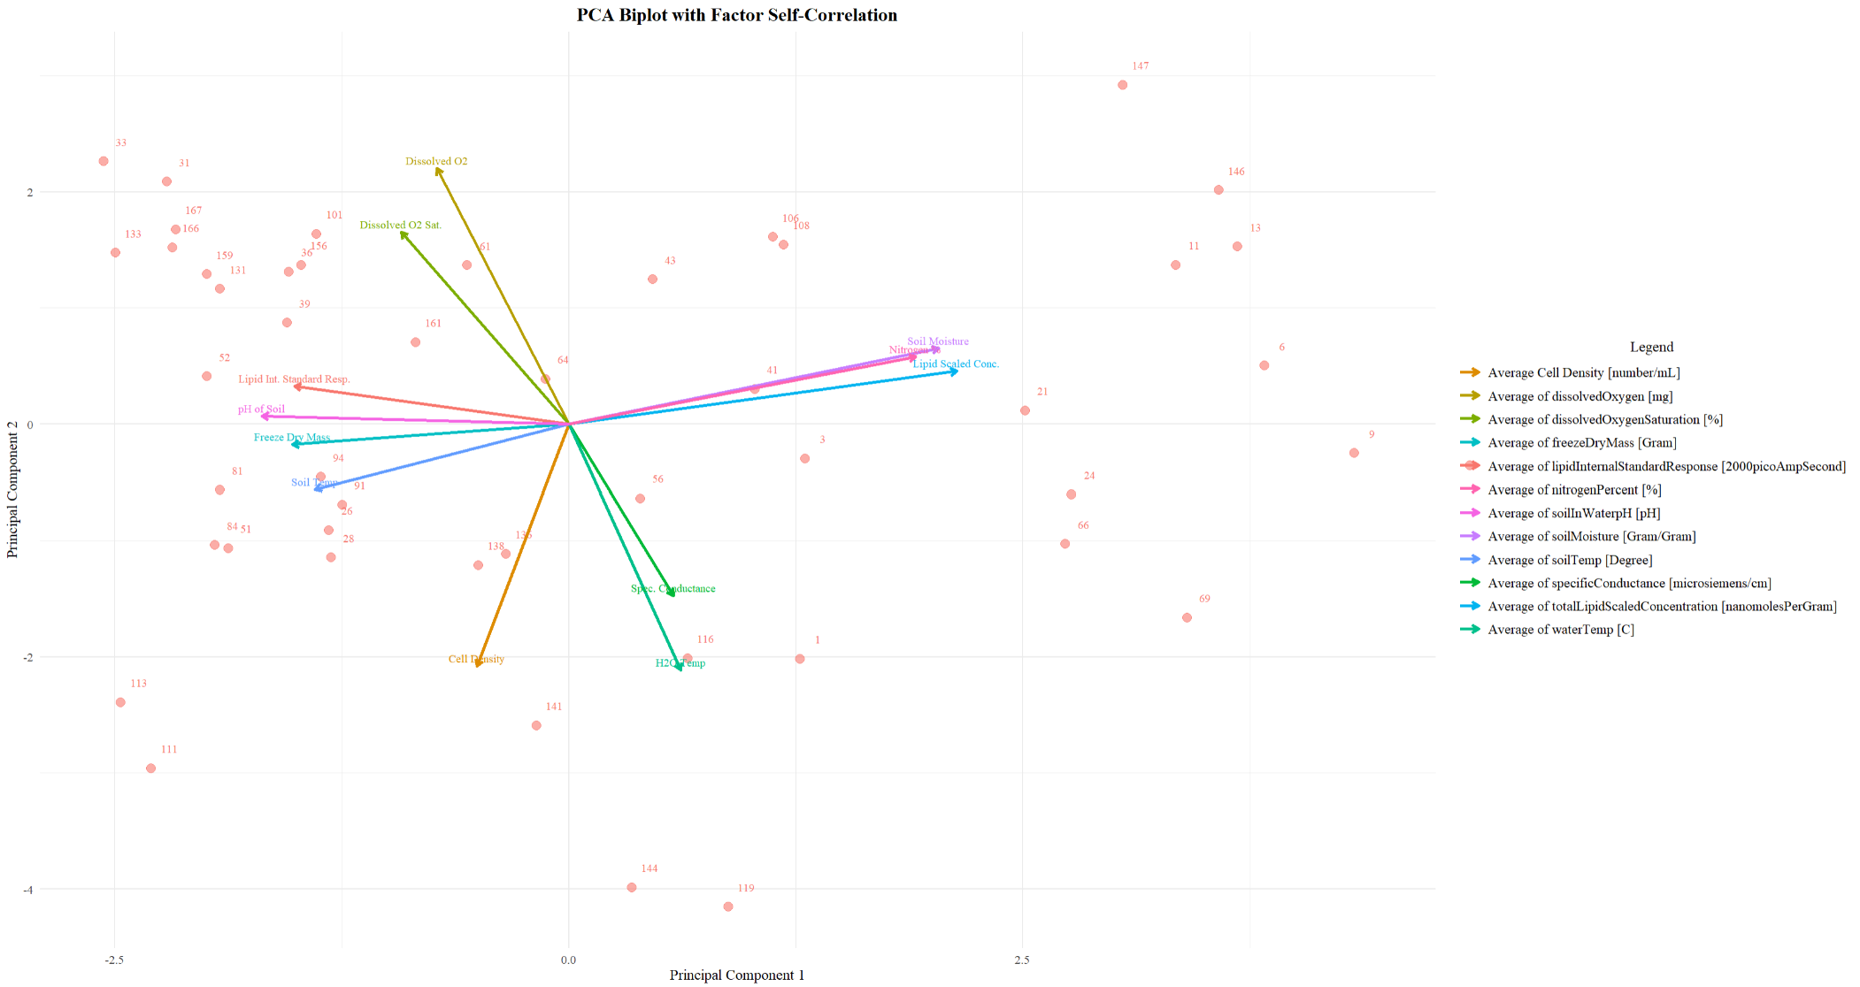
Data integration to investigate Microbial Abundance in Terrestrial and Aquatic Ecosystems and its Causes
Leo Sai^{1,} Xiaofeng Xu^{1,} , David Lipson¹
1. Biology Department, San Diego State University, San Diego, CA, USA; 2. National Ecological Observatory Network, CO, USA
Abstract
Results
Results Cont.
Significance Statement:
Aquatic and terrestrial microbes are the drivers and indicators of climate change that can be quantified through environmental that can be illustrated through a biospheric model developed under a global database. Seasonality and localization of these microorganisms that inhabit in certain abundance represents the acceleration of certain biomechanical feedback loops which can be used in the advancements in green microbiology to sustain and mitigate climate change.
ANOVA
Independent T Test
Figure 4. Nucleic Acid Concentration vs. Mean Copy Number within Various ecosystems. Association plot for various ecosystems to Nucleic Acid Concentration [NAC] and the correlations.
In Figure 4, a weak positive correlation between Nucleic Acid Concentration and Mean copy shows unbiased values as these samples are randomly selected. In the dark blue line figure, a negative correlation exists between Nucleic Acid Concentration and Mean copy number in benthic waters shows a diluted effect within the gene copies of individual microorganisms as not similar which is accurate as these microorganisms can now inhabit archaic microorganisms that are in thermal vents or extremely cold and pressurized environments. Finally, the cyan line illustrates the negative correlation between Nucleic Acid Concentration and Mean copy number in aquatic systems. This shows that within aquatic ecosystems, the DNA is very similar within these microorganisms in these ecosystems.
Previous research explored the specificities of either ecosystems and the effects to sustainability due to their own specific carbon fingerprint affecting necromass, enzymatic activity, and carbon metabolism (Verrone et al., 2024).
Figure 2. Methodology Map. Methodology to analyze categorized raw data samples distributed by NEON.
Materials and Methods
The data used for the analysis in this study are displayed and archived at https://docs.google.com/document/d/1dkufMJ5NSeyass2HviZ3ePuo_Flr25Jb_V59wfEOjsc/edit?usp=sharing
Conclusion/Discussion
Figure 1. Abundance Percentage on Earth. The abundance of various microorganisms and the percentage in each allocated region.
In conclusion, the overall purpose of this study is to provide more insight on the correlation between microorganisms and changes that can occur within factors such as temperature, soil composition, pH, and moisture using data presented from NEON Laboratories to understand key players to help sustain climate change through the perspective of Green Microbiology. Microorganisms play an important role in the vast biomechanical processes that result and effect climate change and the decrease in microbial population and diversity is alarming in both aquatic and terrestrial ecosystems.
The major contributing factors within aquatic ecosystems that help sustain microbial communities are water temperature and specific conductance useful as an accelerant for the hydro pump within the carbon cycle. But, it can also be used as a deterrent to slow down the carbon cycle if these factors are insufficient. In terrestrial ecosystems, factors like soil moisture and soil temperature play dominant roles in being drivers and indicators within the nitrogen cycle which can also be an accelerant or a deterrent to slow down these processes as it directly affects the microorganisms that inhabit this ecosystem.
Future research may be required for further advancements to this study such as the observation of changes through seasonal periods of time with correlation to the abundance of microorganisms that can provide insight on the temperature changes that occur from passage of time and when microorganisms are at their peak or their worse to evaluate biological process rates. As stated before, there is still so much information that is unknown about microorganisms and the roles they play within the grand scheme of climate change, but a goal that this study strived for was to get more insight and inspire more research to be done through microorganisms to find technological solutions to sustainability through Green Microbiology.
Introduction
In Figure 1, the abundance of microorganisms across aquatic and terrestrial environments largely consisting of bacteria which can be due to the optimal living conditions that the bacteria inhabit. Some outliers in the west and east coast showed higher density of eukaryotic microorganisms which can be explained through species like protozoa that feed on organic matter for larger organisms to feed on like shrimp. In the middle region of America, there are high density spots of unclassified microorganisms which can represent various explanations with the likelihood of unculturable species.
Figure 3. Correlation Matrix of Factors and Microbial Population. Relative variation in seasonal temporal scale in correlation to microbial cell density in aquatic systems and biomass in terrestrial systems.
In Figure 3, there is a clear correlation between specific conductance and water temperature in relation to microbial cell density in various sites within the USA in the aquatic ecosystem. Therefore, the major contributing factor for sustainability of these communities as well as key factors to drastically affect the carbon cycle. Specific conductance affects the carbon cycle by influencing the rate of photosynthesis while specific conductance indicates dissolved materials for growth to enhance the uptake within aquatic ecosystems. Factors like freeze-dry mass, lipid concentration, and lipid response provide no significant correlation as lipid concentration is for the sustainability of the cell membrane for energy and fluidity as most bacteria have cell walls. Finally, there is a clear correlation between soil moisture and soil temperature that contribute to the biomass in the terrestrial as an accelerant for processes like nitrification, ammonification, and denitrification which directly influences the decomposition of organic material (Guntiñas et al., 2012).
Climate change has created a decline in soil microbial biomass across the globe from 1992 to 2013. There is little knowledge in the aspect of the biomechanical processing that incorporates the result of climate change. In aquatic ecosystems, the carbon cycled through these microorganisms eventually a majority of carbon ends up at the bottom of the ocean through cyanobacteria and phytoplankton which can create a nutrient imbalance while reducing the amount of carbon in the air. Microbes in aquatic ecosystems play a dominant role in “pumping” carbon into the ocean into the soil similar to a “conveyor belt” that transports and stores carbon in oceans within these high pressurized environments (Sanmukh et al., 2015).
In terrestrial ecosystems, soil microbes play major roles in decomposition of organic. Terrestrial ecosystems and aquatic ecosystems rely on both parties creating a complex feedback loops and understanding these interactions in this feedback loop are critical for predicting impacts of climate change and developing strategies and technological advancements to mitigate and sustain these effects.
The significance of analyzing microbial communities in various environments is to view the vast potential of microorganisms to learn more about climate change and to incorporate this knowledge for the use in Green Microbiology to find sustainable solutions to ocean acidification, melting glaciers, and air pollution.
Acknowledgments
This study has been supported by an NSF CAREER project (2145130). We acknowledge the operation of the NEON supported by the NSF.

Slide 2
simplify the text and put like a few sentences for each figure (3-4 sentences) and take home message
font size title 36-48, in text (32-36)?
independent t test for all figures and put into a table or figure
figure 3 compare with independent t test bar chart (do all figures)
this is last step structural equation modeling for control in aquatic and terrestrial ecosystems find difference in control
sequential learning model regression

